Slide 1

A Momentum-based Bipedal Balance Controller
Yuting Ye
May 10, 2006

Slide 2

Outline
Motivation
Resolved momentum control
Implementation and discussion
Result and conclusion
Future work

Slide 3
Motivation
Motion Capture
  Ground truth kinematics
  Apply to different skeleton
    Motion retargeting [M. Gleicher 1998]
  Interpolation for motion synthesis
    Motion graphs [L. Kovar et al. 2002]
  NO kinetics
    Violate physical rules
  Cannot record everything
    Falling, martial art combat
    Re-capturing is expensive

Slide 4
Motivation
Physical simulation
  Physically correct (somewhat)
  Hard to develop, parameters tuning
    Composable [P. Faloutsos et al. 2001]
  What to simulate?
    Reactive [V. Zordan et al. 2002]
  Balance is a big problem!
Constraints
  Data driven and physically correct
  Objectives and constraints? (momenta)
  Expensive

Slide 5
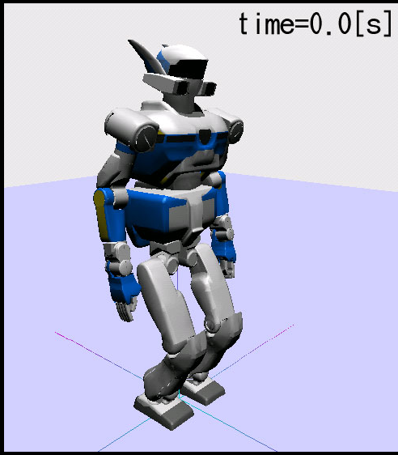
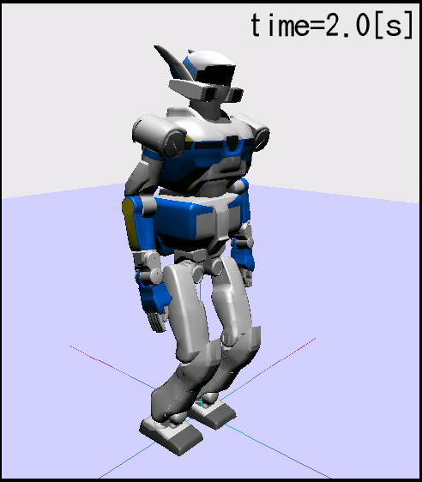
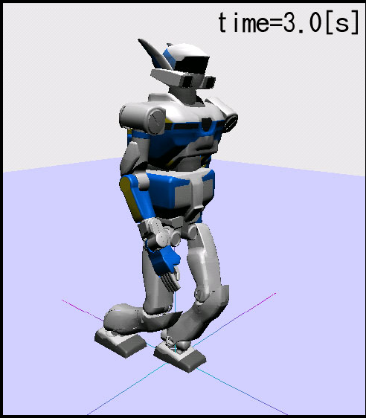
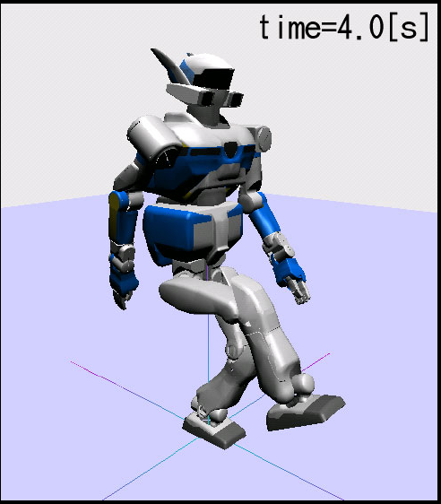
Motivation
The robotics community
  S. Kajita et al. 2003, Resolved momentum control: humanoid motion planning based on the linear and angular momentum
  Simple control schema for whole body motion
  Works on humanoid robots -- balanced
  Is it general enough?
  Don’t be scared by the equations, just high school level physics ☺

Slide 6
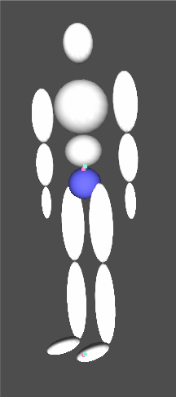
Resolved momentum control
Skeleton
Hip
Waist
Left femur
Right femur
Torso
Left tibia
Right tibia
head
Left humerus
Right humerus
Left foot
Right foot
Left radius
Right radius
Left hand
Right hand
Data from D. A. Winter, 2005, “Biomechanics and Motor Control of Human Movement, 3rd Edition”

Slide 7
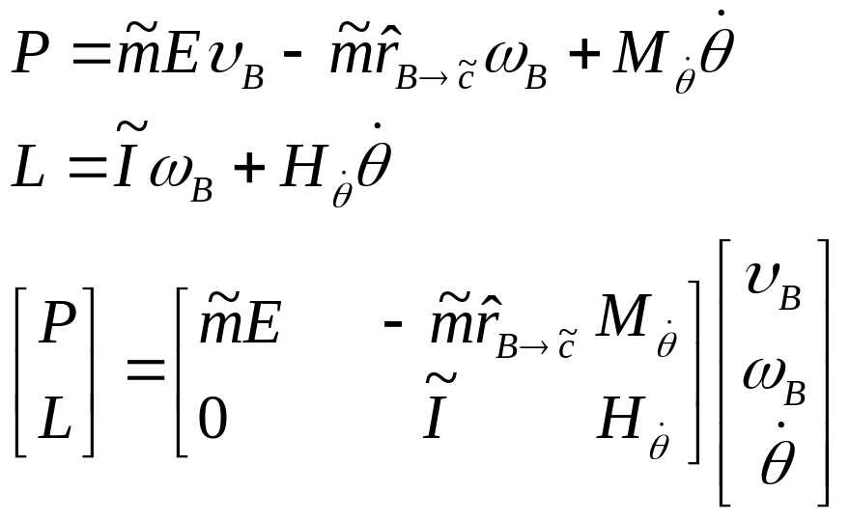
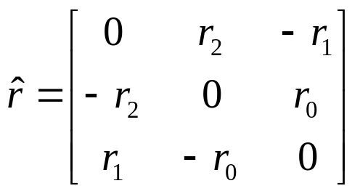
Resolved momentum control
Basic idea
  To control the linear and angular momenta with the motion of joints

Slide 8
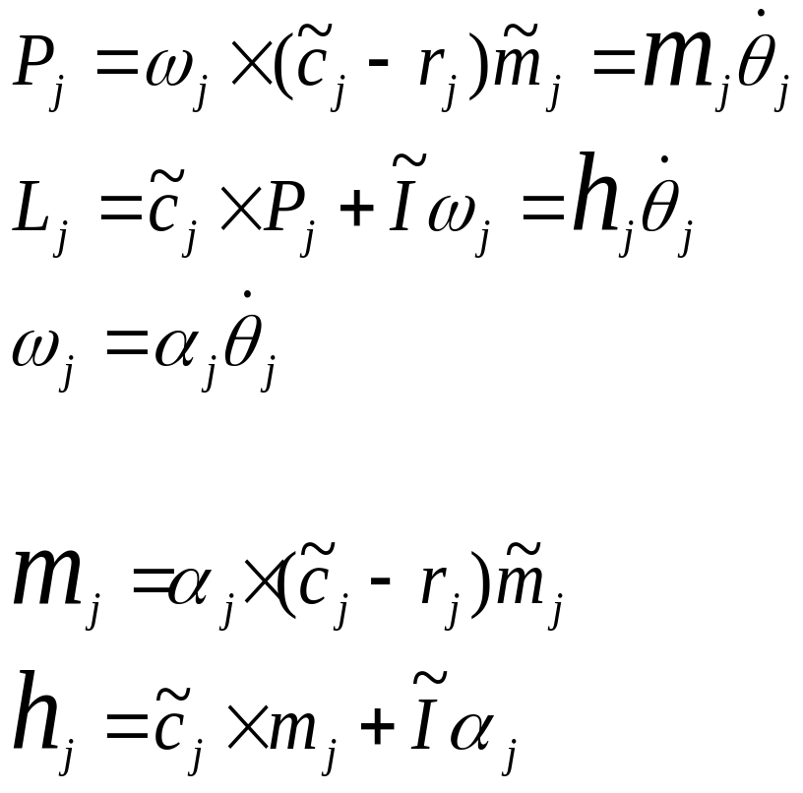



Resolved momentum control
Calculate the inertia matrices

Slide 9
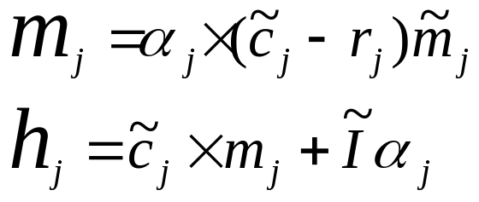


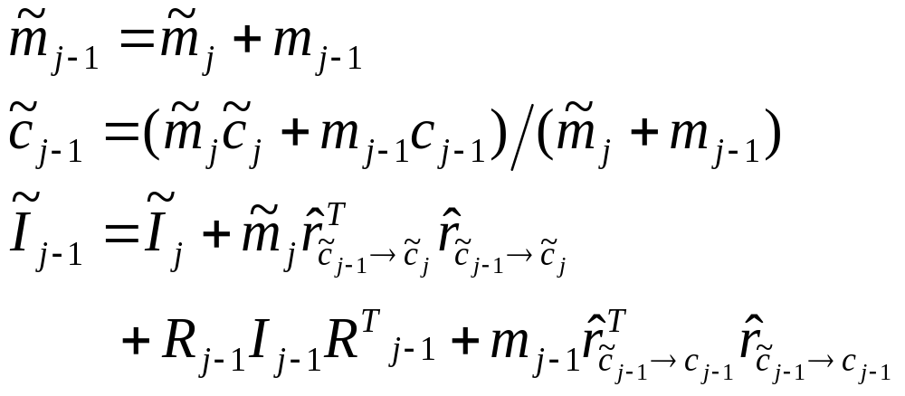
Resolved momentum control
Calculate the inertia matrices
j-1
j

Slide 10
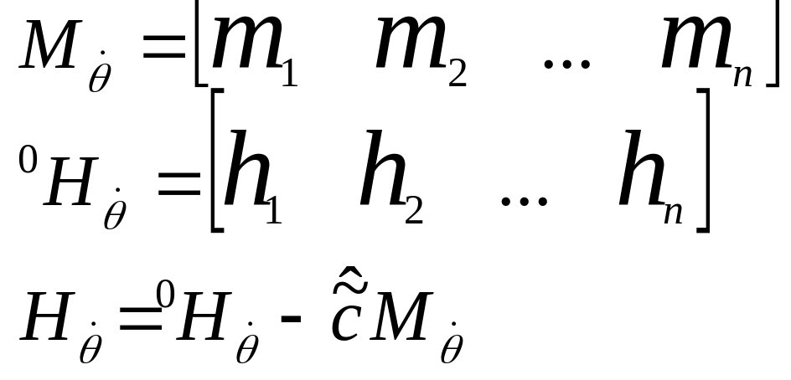
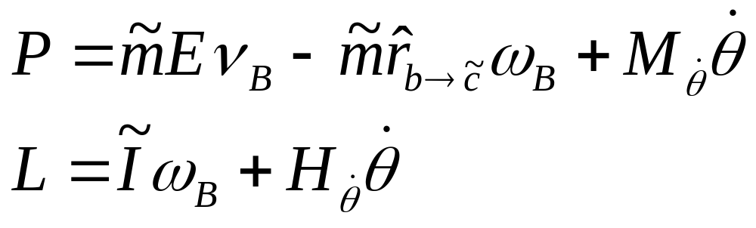
Resolved momentum control
Calculate the inertia matrices

Slide 11

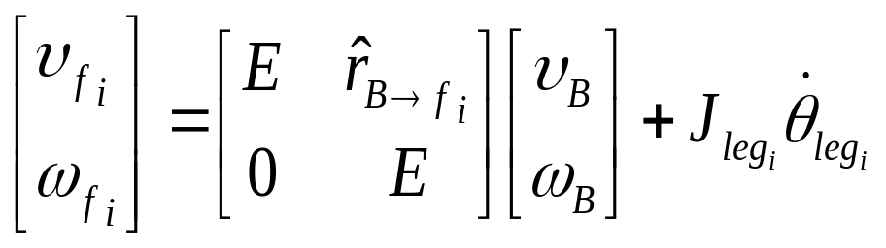
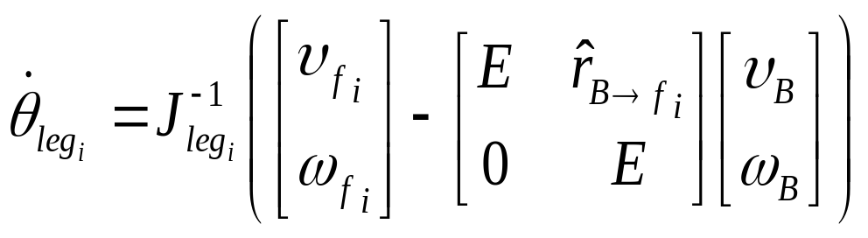
Resolved momentum control
Modeling ground contact
  Specify motions of the feet

Slide 12


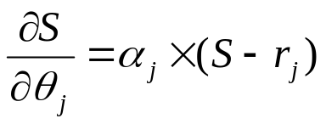



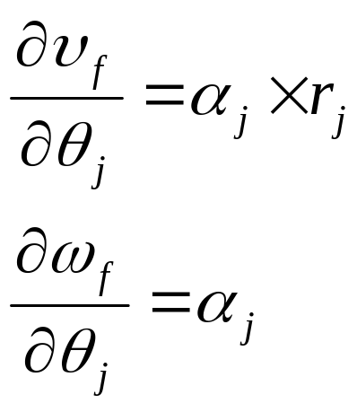
Resolved momentum control
Calculate the Jacobian matrix
  Same as in inverse kinematics
?
?
S
End Effector
?
j

Slide 13
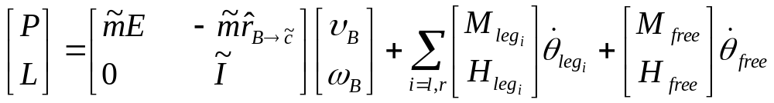

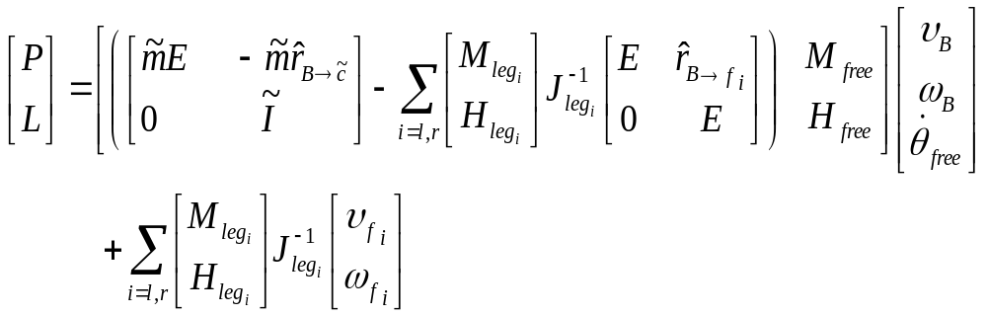
Resolved momentum control
Putting things together

Slide 14
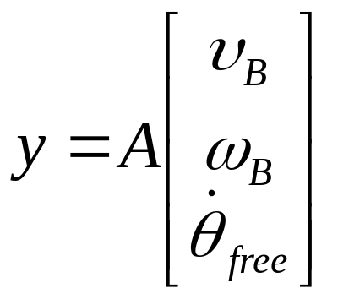
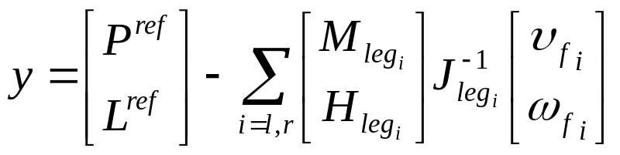
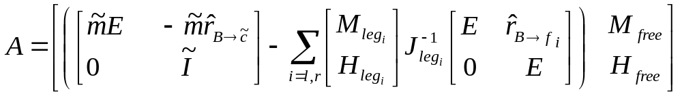
Resolved momentum control
Putting things together

Slide 15
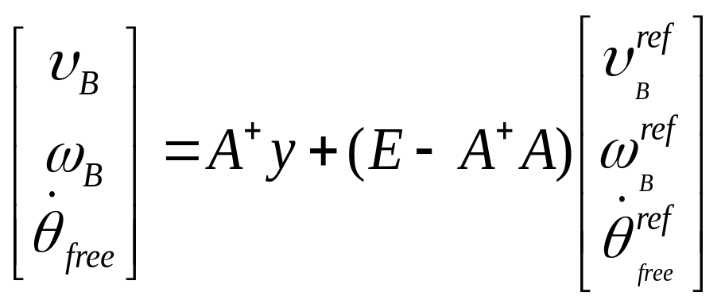
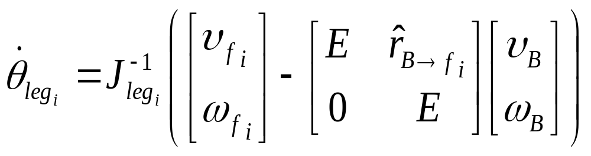
Resolved momentum control
Putting things together

Slide 16
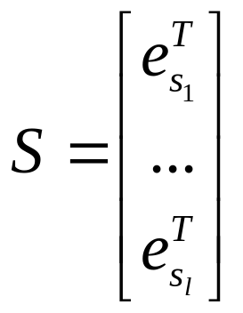

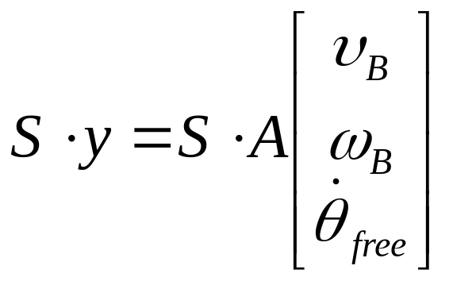

Implementation and Discussion
ODE – Physical simulation
  Compensation for resolving collision: small timestep
  30 frames/sec, 30/10 iterations per frame
Select what to control
-- a 6x1 column vector that has 1 at s_{ith} row and 0 for the rest
e.g.

Slide 17


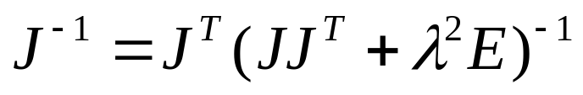
Implementation and Discussion
Analogy to inverse kinematics
  Replace the end effector with momenta and velocities
    Partial derivative, SINGULARITY
  Matrix inversion
    Pseudo Inverse
    SVD
    Damped Least Squares

Slide 18
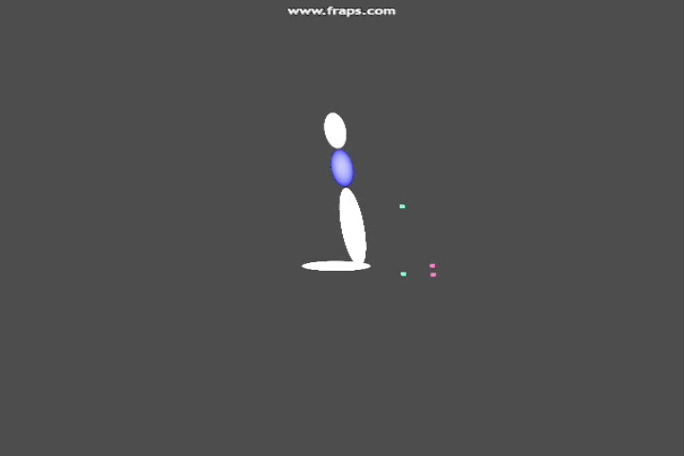
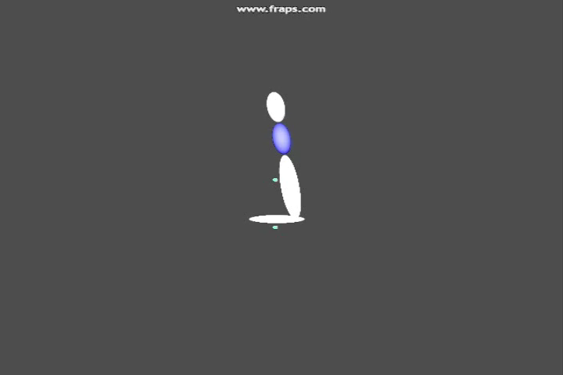
Implementation and Discussion
Example

Slide 19
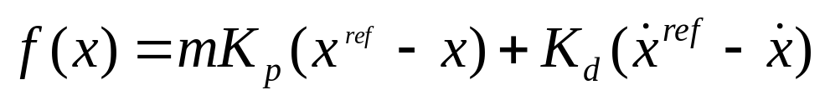
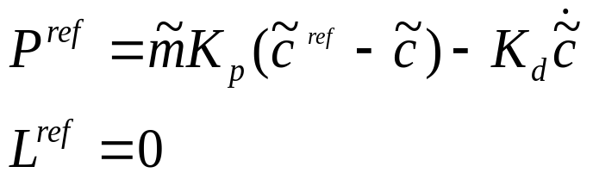
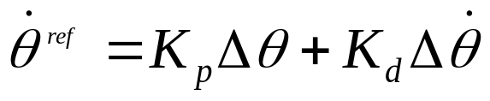
Implementation and Discussion
PD servo for reference values
  Proportional Plus Derivative (PD) Feedback System
  K_{p} is the spring factor and K_{d} is the damping factor
Get the reference values

Slide 20
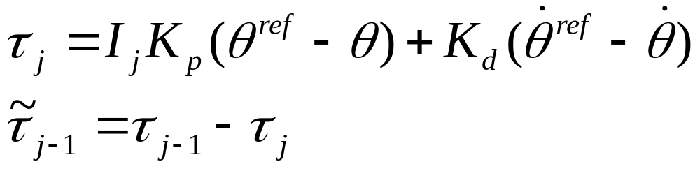
Implementation and Discussion
PD Controller
  For one leg
  Tune the gains for each joint – scale by inertia

Slide 21
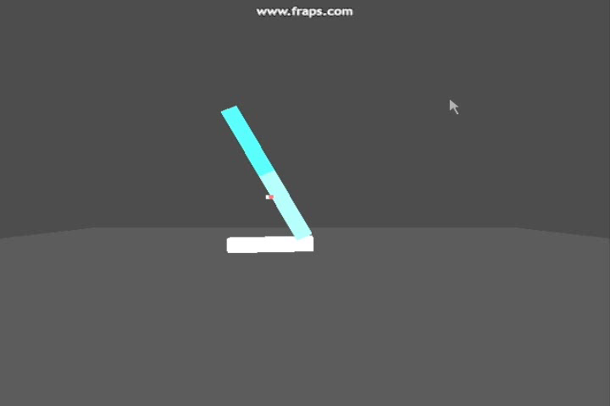
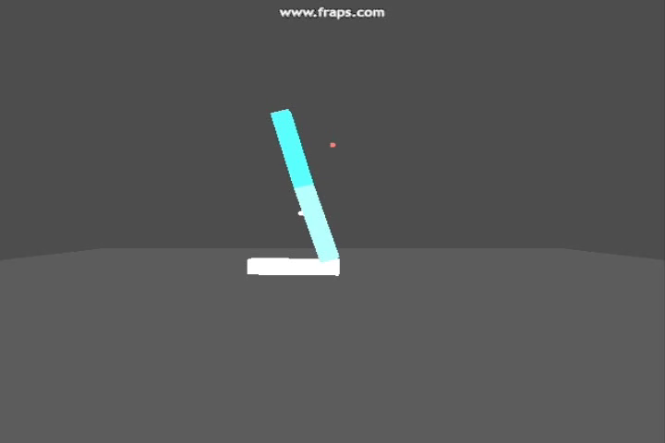
Results
Simplest case
Max Force: 100, 250
Push: [-600 600]

Slide 22
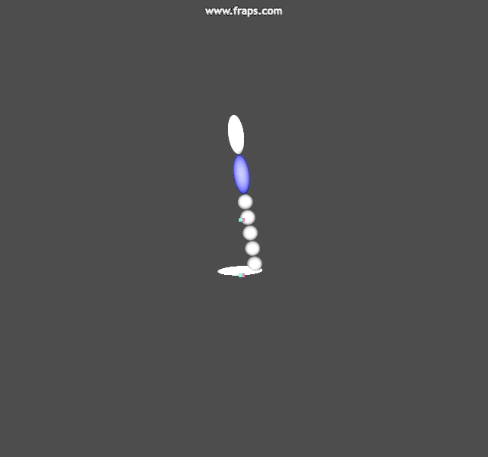
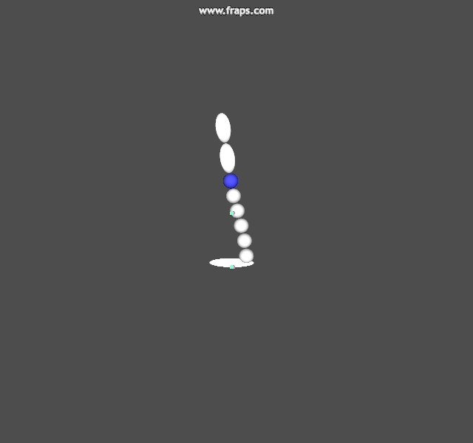
Results
Single leg, multiple 1D joints
Max Force: 200
Push: -350, 350

Slide 23
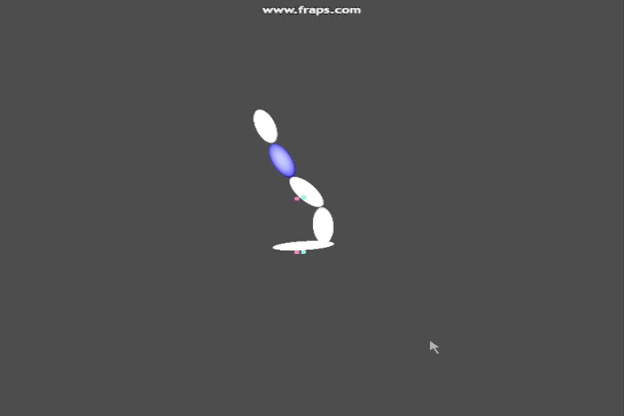
Results
Unstable

Slide 24
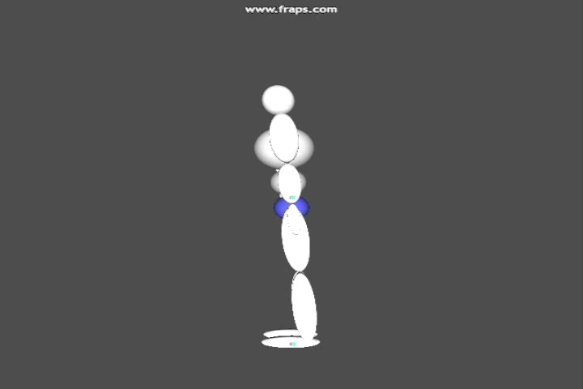
Results
Humanoid - stand

Slide 25
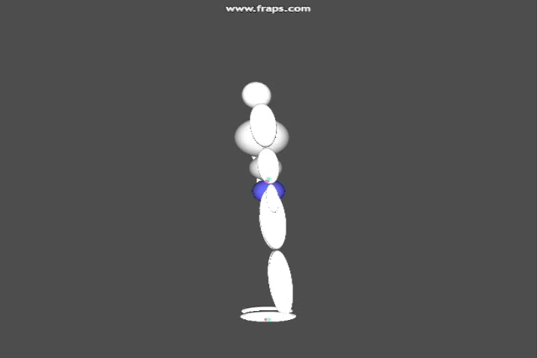
Results
Humanoid – slightly pushed
Max Force: 1500
Push: 900

Slide 26
Conclusion
A simple control schema
  Few parameters to tune
Stable
Fits well in data-driven simulation
Matrix singularity
  Highly sensitive to any error
Good understanding of physics required

Slide 27
Future work
Ground contact
Integrated with motion capture data
  Obtain the reference values
    Walking, protective steps
  Replicate the motion with reaction
Interpolation
  Finding transition points; as constraints
Motion composition
  Momenta of kicking + jumping
  = jumping kick?

Slide 28
Thank YOU!!!
Questions and comments?

